Slide 1
INTRODUCTION TO MARKETING
0
Chapter 3
The Cultural
Environment
NGUYEN THI PHUONG*
THANG LONG UNIVERSITY
*MA in Global Marketing, PHD in Economics

Slide 2
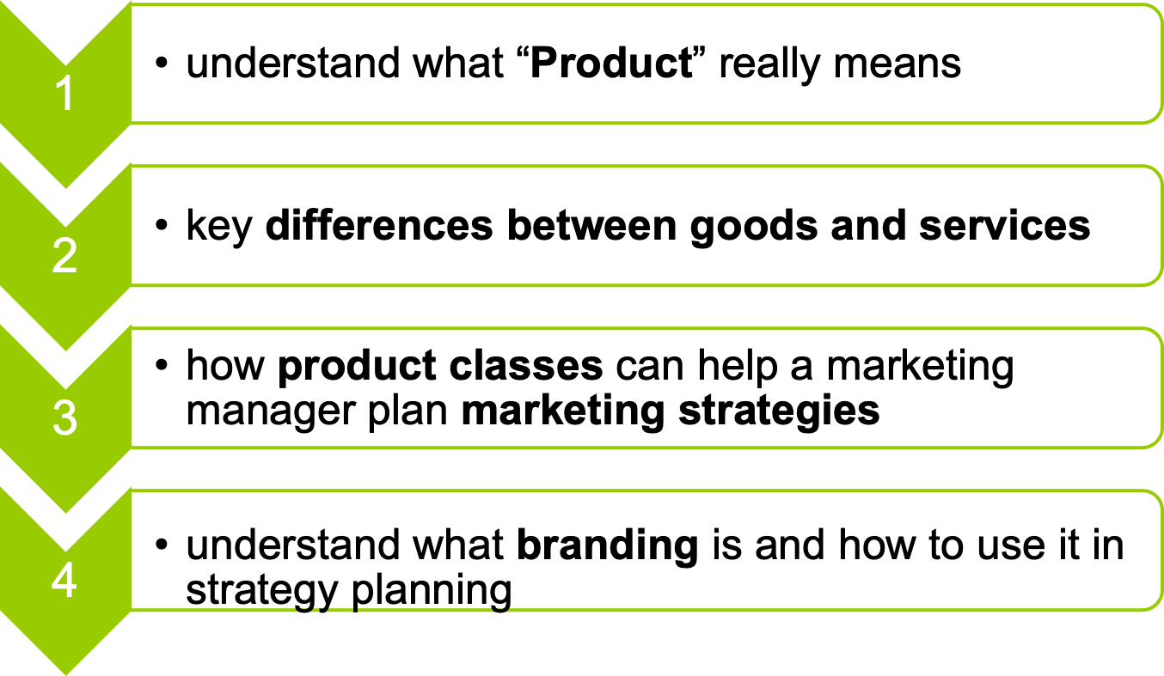
SESSION 8: Product and brand strategy
Copyright © 2011 Pearson Education
15-<number>

Slide 3
8.1 What is a product?
Product means the need – satisfying offering of a firm (nhu cầu thỏa mãn chào bán của một công ty)
Most customers think about a product in terms of the total satisfaction it provides. That satisfaction may require excellent service, a physical good with the right features, useful instructions, a convenient package, a trustworthy warranty, a familiar name, etc
Copyright © 2011 Pearson Education
15-<number>

Slide 4
Product quality means a product’s ability to satisfy a customer’s needs or requirements.
For example, the “best” satellite TV service may not be the one with the highest number of channels but the one that includes a local channel that a consumer wants to watch
A good is a physical thing which can be seen and touched
Service is intangible. It is a valuable action, deed, or effort performed to satisfy a need or to fulfill a demand.
Copyright © 2011 Pearson Education
15-<number>

Slide 5
8.2 Product classes help plan marketing strategies
All products are based on the type of customer that will use them.
Consumer products are products meant for the final consumer.
Business products are products meant for use in producing other products.
Copyright © 2011 Pearson Education
15-<number>

Slide 6
Consumer product classes
Consumer product classes divide into four groups: (1) convenience, (2) shopping, (3) specialty, and (4) unsought-chưa mua. Each class is based on the way people buy products.
Business product classes are different from the consumer product classes – because they relate to how and why business firms make purchases. The big difference market is derived demand
Copyright © 2011 Pearson Education
15-<number>

Slide 7
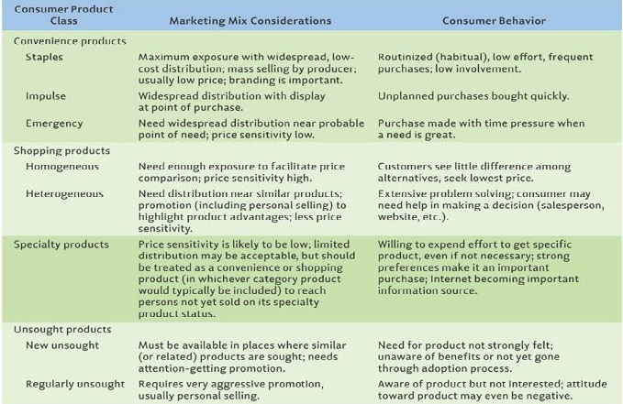
Product classifications
Copyright © 2011 Pearson Education
15-<number>

Slide 8

8.3 Branding
Company’s brand includes name, logo and slogan. A brand represents your company’s daily interactions with customers and evokes emotion that calls your customer base to action
Copyright © 2011 Pearson Education
15-<number>

Slide 9
Branding
Branding means the use of a name, term, symbol, or design – or a combination of these – to identify a product. It includes the use of brand names, trademarks, and practically all other means of product identification.
Brand name has a narrower meaning. A brand name is a word, letter, or a group of words or letters
Copyright © 2011 Pearson Education
15-<number>

Slide 10
There are five level of brand familiarity are useful for strategy planning:
Brand rejection: means that potential customers won’t buy a brand unless its image is change. Overcoming a negative image is difficult and can be very expensive
Brand non-recognition: means final consumers don’t recognize a brand at all-even though intermediaries may use the brand name for identification and inventory control.
Brand recognition: means that customers remember the brand
Copyright © 2011 Pearson Education
15-<number>

Slide 11
Brand preference: means target customers usually choose the brand over other brands, perhaps because of habit or favorable past experience.
Brand insistence: means customers insist on a firm’s branded product and are willing to search for it. This is an objective of many target marketers
A good brand name can help build brand familiarity. It can help tell something important about the company or its product.
Copyright © 2011 Pearson Education
15-<number>

Slide 12
Characteristics of a good brand name
Short and simple Easy to spell and read Easy to recognize and remember Easy to pronounce Can be pronounced in only one way Can be pronounced in all languages (for international markets) | Suggestive of product benefits Adaptable to packaging/ labeling needs No undesirable imagery Always timely (does not go out-of-date) Adaptable to any advertising medium Legally available for use (not in use by another firm)
Copyright © 2011 Pearson Education
15-<number>

Slide 13
Companies that compete in international markets face a special problem in selecting brand names. A name that conveys a positive image in one language may be meaningless in another
For example: GM stuck with the Nova name when it introduced the car in South America. Nova is the Spanish word for star. However, Nova also sounds the same as the Spanish words “no go”.
Question: Take your five examples about brand name of levels of brand familiarity and explain your choice
Copyright © 2011 Pearson Education
15-<number>

Slide 14
Manufacturer vs. Private Brands
Manufacturer brands are brands created by producers
Private brands are brands created by middlemen
For example, major drugstore chains routinely offer their own private-label brands or products created by big supermarkets (Walmart)
Copyright © 2011 Pearson Education
15-<number>

Slide 15
Individual vs. Family Brands
Individual branding is a strategic approach used by firms with sufficient resources to create a separate identity for each product they offer.
Family branding are firms with multiple offerings in the same category, like soup or cereal, often market a variety of products under the same name.
Copyright © 2011 Pearson Education
15-<number>

Slide 16
Co-branding
Co-branding is a strategy that links two existing brand names to create an identity for a new product.
Ingredient branding: one product is integral to the other, like an ice cream brand blended with liquor.
Cooperative branding involves two or more brands sharing a promotion. For example, Hilton Hotels and Hertz might advertise jointly for holiday vacationers.
Complementary branding: are marketed together to suggest the benefits of using both, like a restaurant offering discounts at a local movie theater
Copyright © 2011 Pearson Education
15-<number>

Slide 17
Trademarks
Regardless of which branding strategy, marketers often seek trademark protection.
Trademark is a legal term. A trademark includes only those words, symbols, or marks that are legally registered for use by a single company
This gives them exclusive rights to the brand name, symbol and design, enforced by law and involving penalties for unauthorized use
Copyright © 2011 Pearson Education
15-<number>

Slide 18
A brand strategy should have:
Positioning: Decide whether consumers to think of your product as less expensive than the competition or higher quality than the competition
Benefits: align with core business values and mission, have clear meaning and relevance to your target consumer
Considerations: advertising campaigns, company literature, public perception and customer commitment.
Copyright © 2011 Pearson Education
15-<number>

Slide 19
Homework
1. Define, in your own words, what a Product is.
2. Discuss several ways in which physical goods are different from pure services. Give an example of a good and then an example of a service that illustrates each of the differences.
3. What kinds of consumer products are the following: (a) watches, (b) automobiles, (c) toothpastes? Explain your reasoning.
Copyright © 2011 Pearson Education
15-<number>

